Slide 1
Sentiment Analysis using Naïve Bayes and Word Embeddings
WiDS Project
By:
Oshin
Roll No: 190110056
Btech, 3rd Year
Department of Metallurgy and Material Sciences

Slide 2
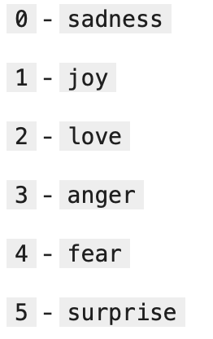
Learnings
Modelling a text data.
The role of preprocessing in improving accuracy of predictions.
Building the model using Naïve Bayes, and further improving it using Ensemble technique.
Re-building the model using Word Embeddings, and improving it using CNN and Dropouts for regularization.
The working of the Kaggle interface.
Experimenting with different features within the same algorithm in order to obtain maximum results.
ImageSource- Dataset

Slide 3
Data Pre-Processing
In this dataset, no digits and emoticons or use of any other language other than English was present. Also, all the letters were initially lowercased.
Basic pre-processing tasks were performed including:-
Removal of duplicate sentences with same label.
Plotting of frequency of words histogram and removing the rare ones.
Checked for punctuations and weird characters using ‘re’ library.
Removal of stop words using ‘NLTK’ library.
Lemmatization using ‘NLTK’ library.
Data augmentation- Adding more 5 labels by translating it to French and then back to English.
TFIDF- As model didn’t understand the text data they are converted into a matrix of 0 and 1; where the row size are the number of sentences.

Slide 4
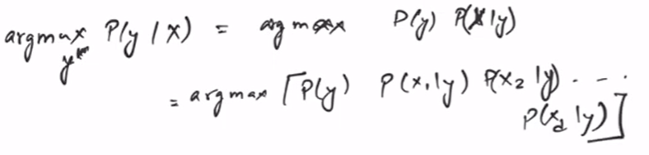
Naïve Bayes Implementation:
Basic idea behind the algorithm is feature independence.
Different number of features were selected for the TFIDF matrix which was then fed to the Compliment NB algortihm due to high imbalance in amount of data labels.
Voting was done from the given output of the NB implemented on different features and based on it a final list of labels were selected.
General Formula of NB

Slide 5
Deep Learning-
Word Embedding based solution
Word Embedding is reducing size of words to a specified number by clubbing similar things together. Individual words are represented as real-valued vectors in a predefined vector space.
To boost the performance of the algorithm further tasks were performed including:-
Word embedding layers was initially flatten, improved to GlobalMaxPool1D with increase in accuracy of the model.
A CNN layer was deployed with 32 filters and kernel size as 5.
Dropout of 0.2 was added after that for the subsequent layer to avoid overfitting.
‘Adamax’ optimizer was used for fitting the dataset with learning rate increased to 0.005 to avoid overfitting.
Categorical cross entropy loss function was used after converting the labels into categorical.

Slide 6
What is CNN?
CNNs are a class of deep learning algorithms that are used for the analysis and classification of visual imagery.
The CNN consists of an input layer, hidden layers, and an output layer and other layers for feature extraction. In CNN the input is a tensor with raster layers of specific height and width.
The convolution is an operation that runs a kernel (a square matrix) of fixed size over each of the layers of the tensor and obtains a value by multiplying each value of the kernel with the value in the input layer and then adding the results and forming a feature matrix using these values.

Slide 7
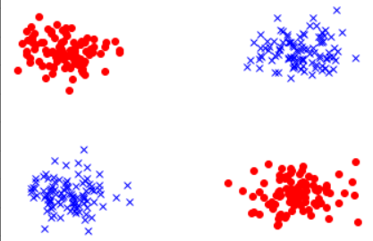
Model Testing and Conclusion:
The input given to the model was in the form of nested list with padding so as to maintain a uniform dimension.
Word embedding based solution gave the output in the form of vector of size of that of labels. Finally Argmax() function was used to get the labels.
In this project, use of non-linear technique of Word Embeddings gave better prediction as compared to the linear Naïve Bayes algorithm. This is because not all labels can be classified using linear techniques no matter how much we do the rotation or transformation of space.
Final Outcome: 91.066%
Image Source: Towards Data Science

Slide 8
THANKING YOU
Link to the code files:
https://github.com/oshin7695/Sentimental-Analysis-WiDS

